Slide 1

Show It!: Better Testing Through Visual Communication
Jess Lancaster @jessclancaster
TechSmith Corporation http://www.linkedin.com/in/jesslancaster
Notes:
Make a note of your questions and we’ll have time to get to them at the end of the talk.
How many of you have used Snagit, Camtasia, Jing?

Slide 2

“Something is happening. We are becoming a visually mediated society. For many, understanding of the world is being accomplished, not through words, but by reading images.” Paul Martin Lester, “Syntactic Theory of Visual Communication”
Notes:
In the 90s

Slide 3

Visual communication is the translation of ideas, stories, and concepts that are largely word-based into a visual format
Notes:
What is Visual Communication? Its the translation of ideas, stories and concepts that are largely textual and/or word based into a visual format, i.e. visual communication.
At its core, visual communication effectively uses images to persuade, entertain, inform, and enlighten an observing audience of products, ideas, and messages.

Slide 4

Notes:
It began with the first humans Painting in caves. Crude images telling a story through pictures.
"Bestias11" by Clemens Schmillen - Own work. Licensed under CC BY-SA 3.0 via Wikimedia Commons - http://commons.wikimedia.org/wiki/File:Bestias11.JPG#mediaviewer/File:Bestias11.JPG

Slide 5
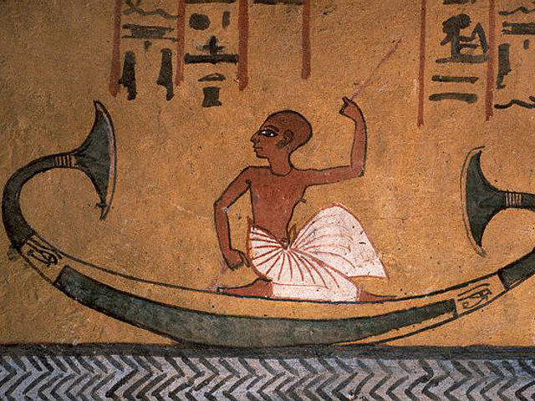
Notes:
To ideograms - a graphical symbol that represents an idea
That combine logographic, alphabetic, and ideographic elements

Slide 6
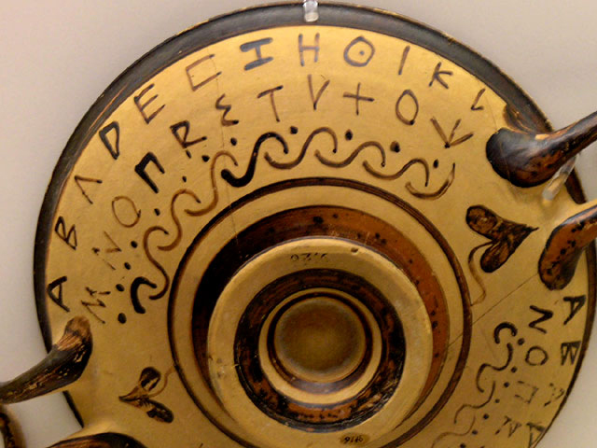
Notes:
To the alphabet
http://www.citrinitas.com/history_of_viscom/images/alphabet/04.html

Slide 7

Notes:
To the printing press

Slide 8
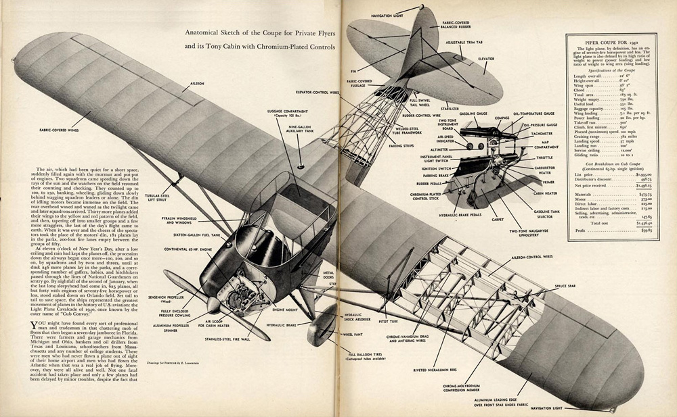
Notes:
To modernism

Slide 9

Notes:
To 3 dimensional data relationships

Slide 10

Notes:
To present day motion graphics – you can see that we have come a long way.
Pixabay: motion graphic

Slide 11
Notes:
We should be making a move back to telling a simple story.
"Bestias11" by Clemens Schmillen - Own work. Licensed under CC BY-SA 3.0 via Wikimedia Commons - http://commons.wikimedia.org/wiki/File:Bestias11.JPG#mediaviewer/File:Bestias11.JPG

Slide 12

Major points to be considered
Simplicity
Clarity
Distinctiveness
Emphasis
Notes:
Simplicity – Ensure the meaning is easily understood – not too confusing or busy
Clarity - Reduce interpretation problems – make it very clear what you mean
Distinctiveness - Drives up believability
Emphasis – make sure the most important information is highlighted
http://www.slideshare.net/sinojm/effective-visual-communication

Slide 13

Visual communication
helps testers and their colleagues come together around information
Notes:
visual communication helps testers and others come together around information. Our teams they use kanban boards to track work – why, it makes the work visible so the team can talk and make decisions about what they see.
Image: Pixabay – one way

Slide 14

Deeper Meaning
Notes:
Imagery can covey a deeper meaning than text – it can often call attention to things that otherwise might not be obvious.

Slide 15
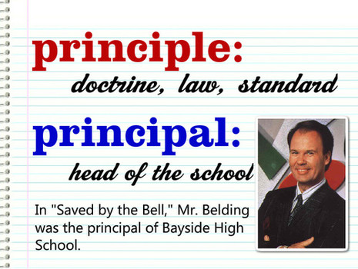
Words are confusing
Notes:
Words can really be confusing – either verbal of written
Have you ever had bugs that were only partially fixed because the wording was misinterpreted or not fully explained?
http://www.examiner.com/article/confusing-and-misused-words-principle-and-principal

Slide 16

Visual communication is
Real time
A time savings
Notes:
As real time as possible – drawing something on a whiteboard is quick.
Time savings when conveying information – doesn’t need to be perfect, just needs to communicate the idea.

Slide 17
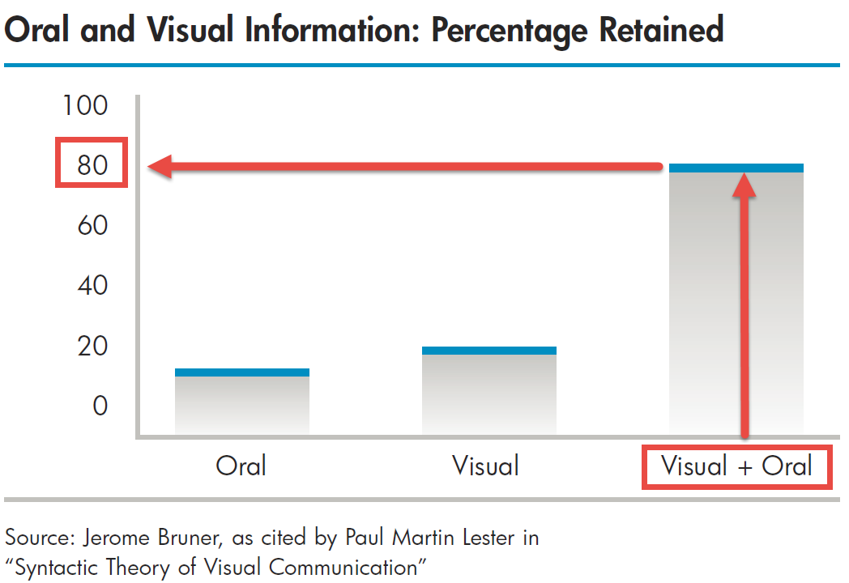
Notes:
Retention is small with oral communication at around 10%, about double that with visual communication, but drastically higher to around 80% when communicated using both methods – that is why video is so compelling,
Studies show that color can have a tremendous effect. According to Ronald Green’s research, color visuals increase the willingness to read by 80% and can positively affect motivation and participation to the same degree.⁷ Color also accounts for 60% of acceptance or rejection of an object,⁸ making it a critical factor in the success of any visual presentation.
7 Ronald E. Green: “The Persuasive Properties of Color,”Marketing Communications, October 1989.
8 Morton Walker, The Power of Color, Avery Publishing Group, 1993.

Slide 18
Squiggle Bugs
Notes:
Dave Gray created an exercise called Squiggle Birds to help people express their ideas using visual thinking. I pondered that idea and modified it for software development purposes. I call it Squiggle Bugs!

Slide 19
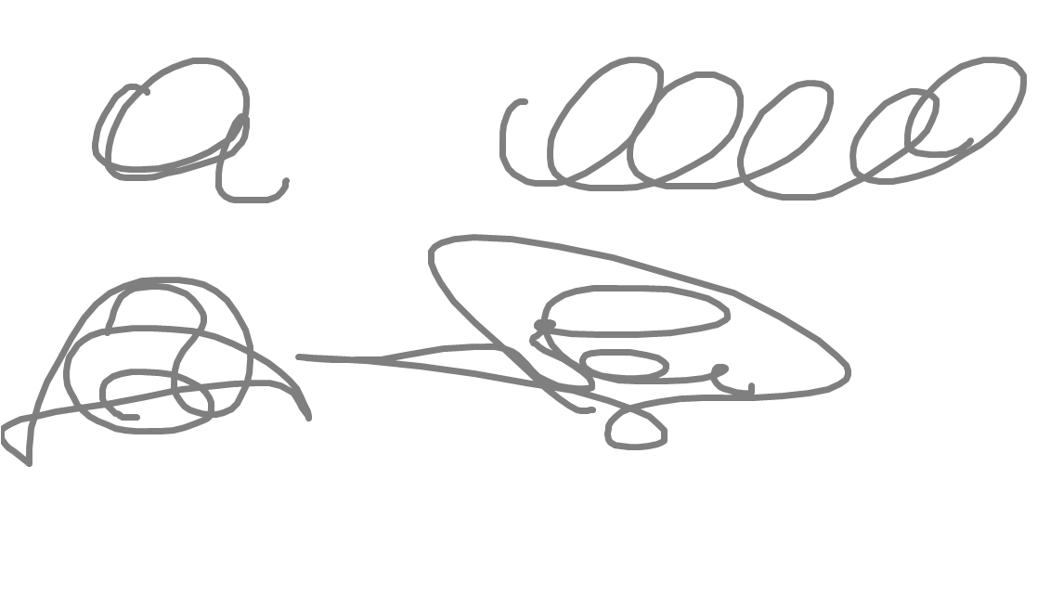
Notes:
So with a sheet of paper and a pen or pencil, take a minute or two and draw 5-10 squiggles of various shapes and sizes. Then, when you have finished, begin to add to these squiggles features that make them bugs! For example…

Slide 20
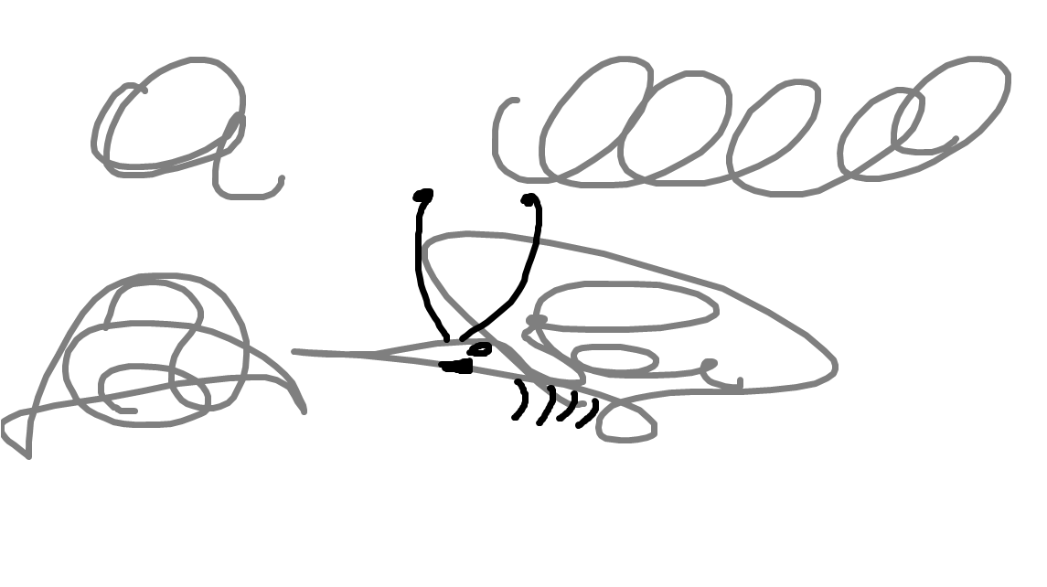

Slide 21
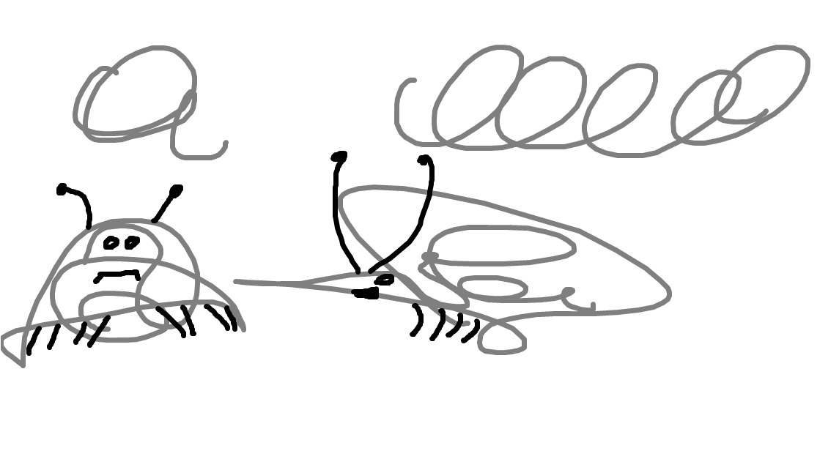

Slide 22
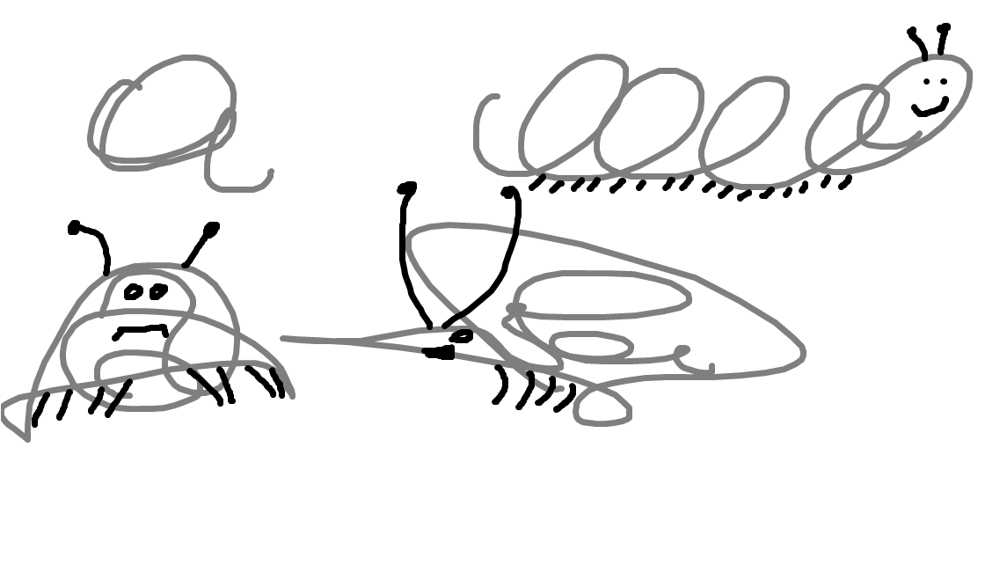

Slide 23
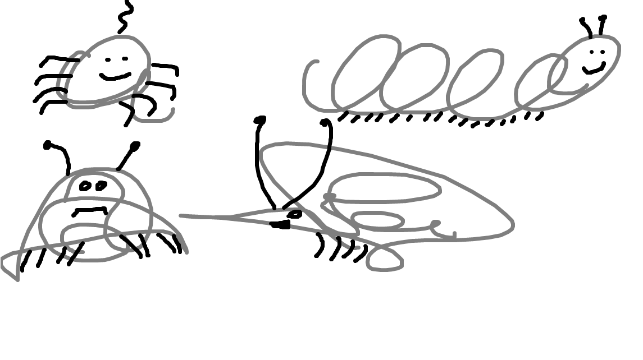
Notes:
The mind is an incredibly flexible instrument. We can find patterns. We can’t help but find things and assign meaning to them. The point is not that you are great at drawing. The point is to help you understand that when you draw to communicate ideas the mind can fill in the details. If there is a concept that you are trying to communicate, try starting with simple visual communication technique like scribbles before complicating it with words.

Slide 24

Notes:
Ok, I understand u. now what can I do about it? Let me share some practical tips and techniques

Slide 25
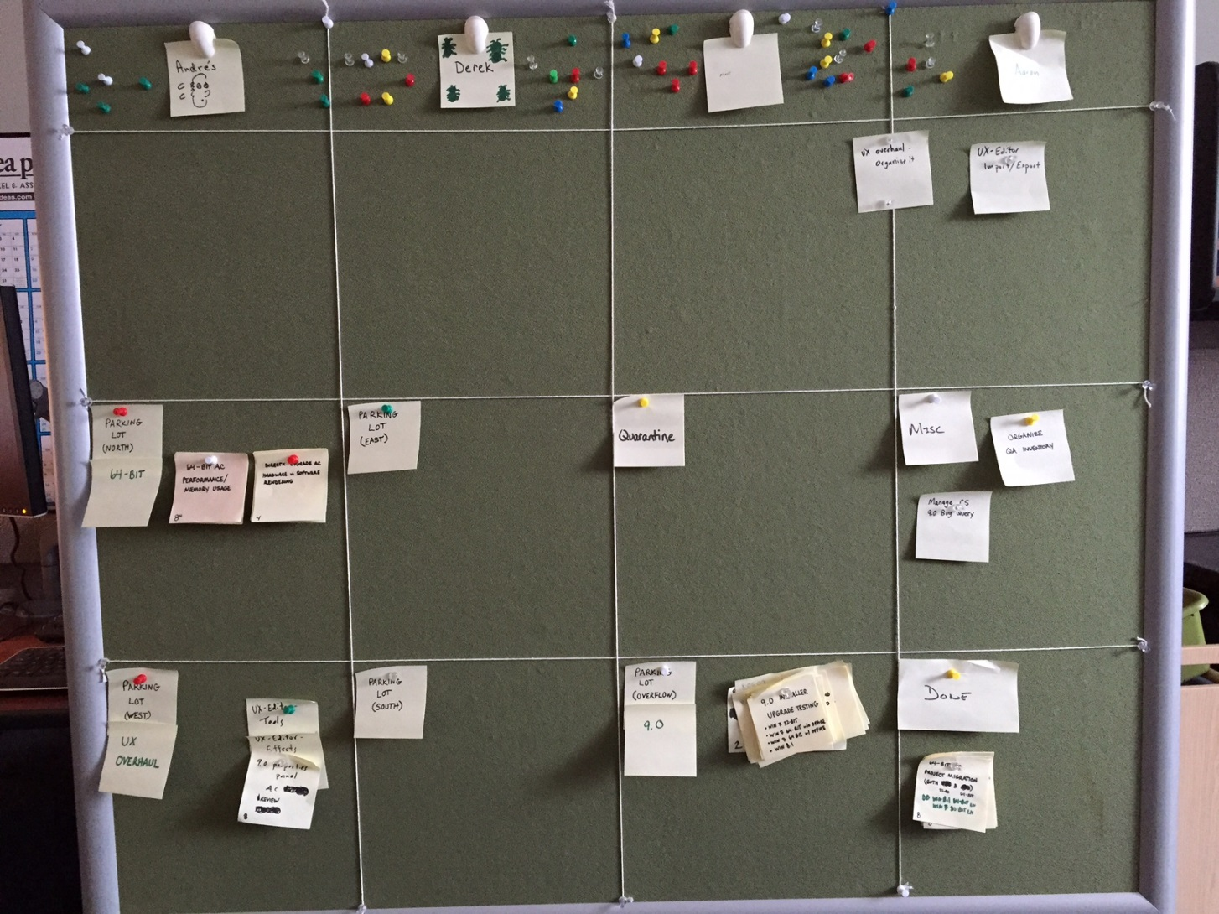
Organizing work with
visual representation
Notes:
Visually representing your work is helpful because it makes it tangible. Such as this example of one of my testing teams version of a kanban board. Making it clear as to what is on their work backlog, what’s in progress, and what’s done. Each morning they’d meet and discuss workload and priority – work gets “load” balanced across the team. It is clear from this picture that Derek needs more work.

Slide 26
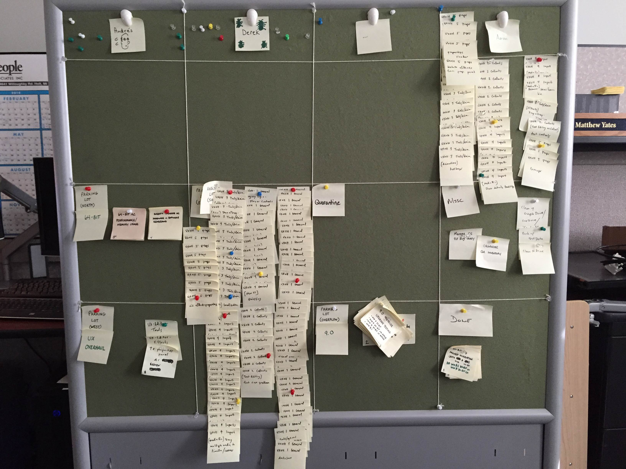
I fixed Derek’s task problem
Notes:
So I fixed that.

Slide 27
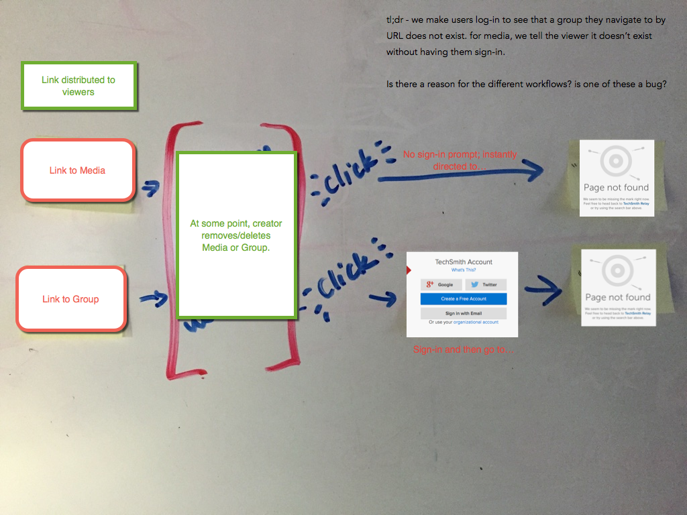
Clarifying workflows with designers, developers, and others
Notes:
Clarifying workflows and system processes - One tester I work with took a picture of a workflow changes and dropped on annotations and screenshots on it to add deeper meaning to the conversation. Is this what you meant? Because I walked through this and arrived a Page not Found.

Slide 28
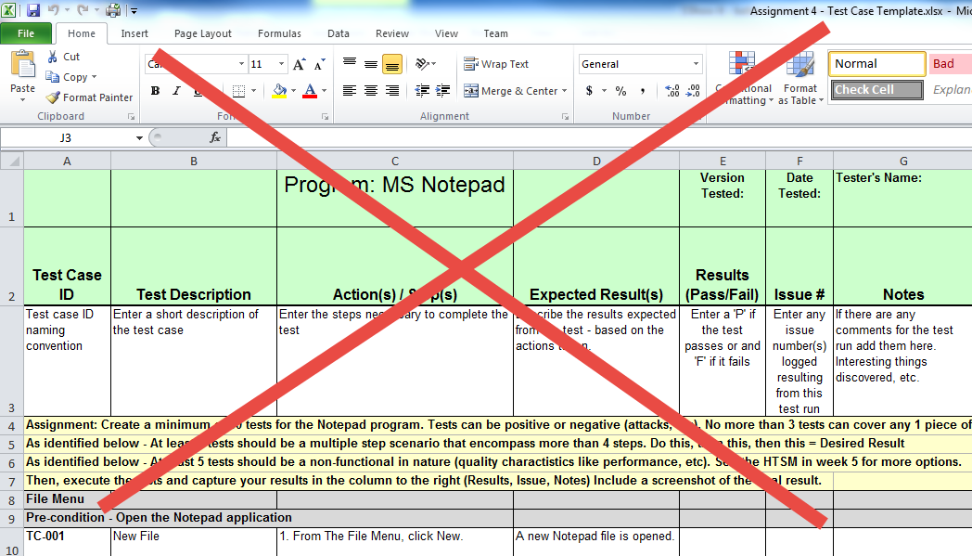
For organizing your test designs – don’t write it
Notes:
Test Design – I’ve personally undergone a paradigm shift in test design. The key considerations for test design can get lost in a 700 row Excel spreadsheet or a 40 page word document! I can’t even figure out what is being tested in this. What’s better?

Slide 29
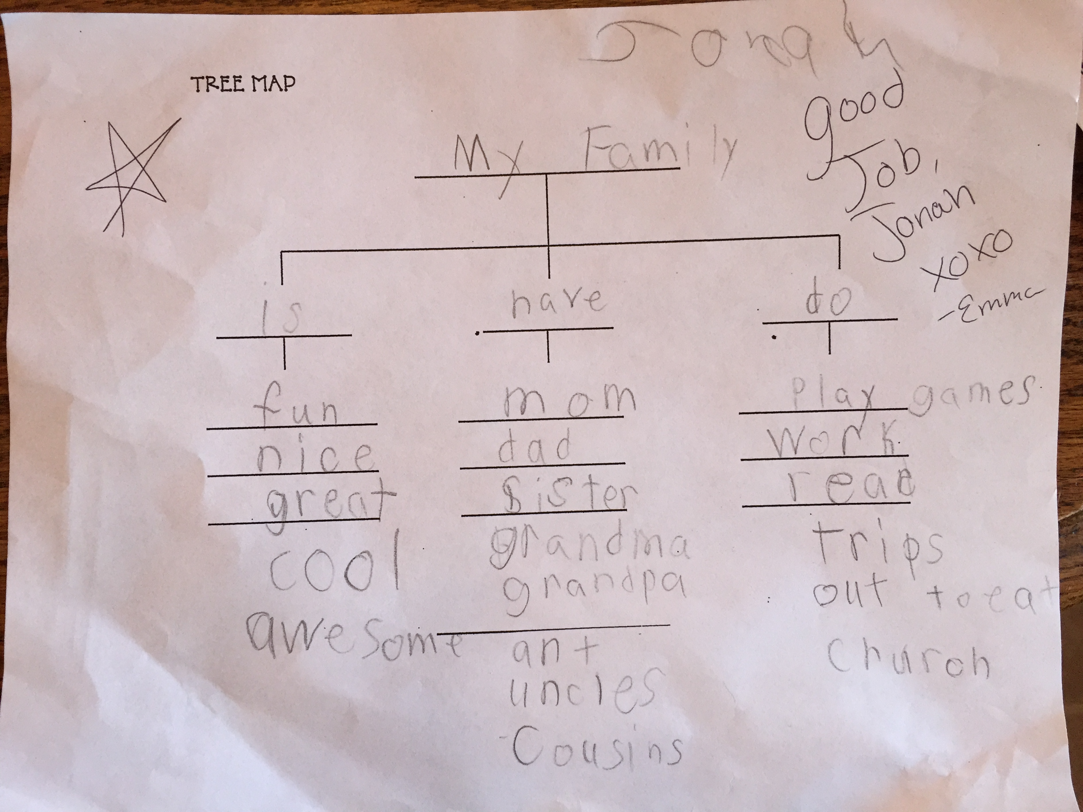
Notes:
Maps. Visual representations of information. One tester I worked with said mind maps are hard. Here’s one my first grader did at school last year about the characteristics of our family. You can do this! Its like riding a bike. When you fall down get back up and try again. As you can see he might have a future as a tester because he’s tested beyond the limits of the input fields.

Slide 30
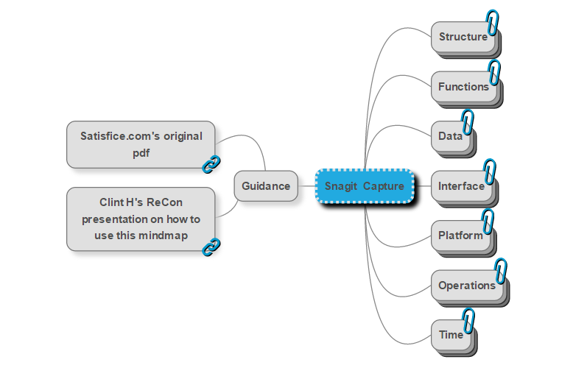
For organizing your test designs – Show It!
Notes:
Where to begin when designing the tests that are needed for a new project or a new product. Use a mind map to organize your test design ideas!
Mind maps allow you to present information visually – organizing information, identifying relationships and associations.
This is an awesome tool for participation in collaborative test design.
In this example we have a simple “starting” map that allows our testers to generate their ideas. There are several tools you can use: this is MindMup running in Chrome, but others use Xmind or other tools. We like Mindmup for its collaboration features.

Slide 31
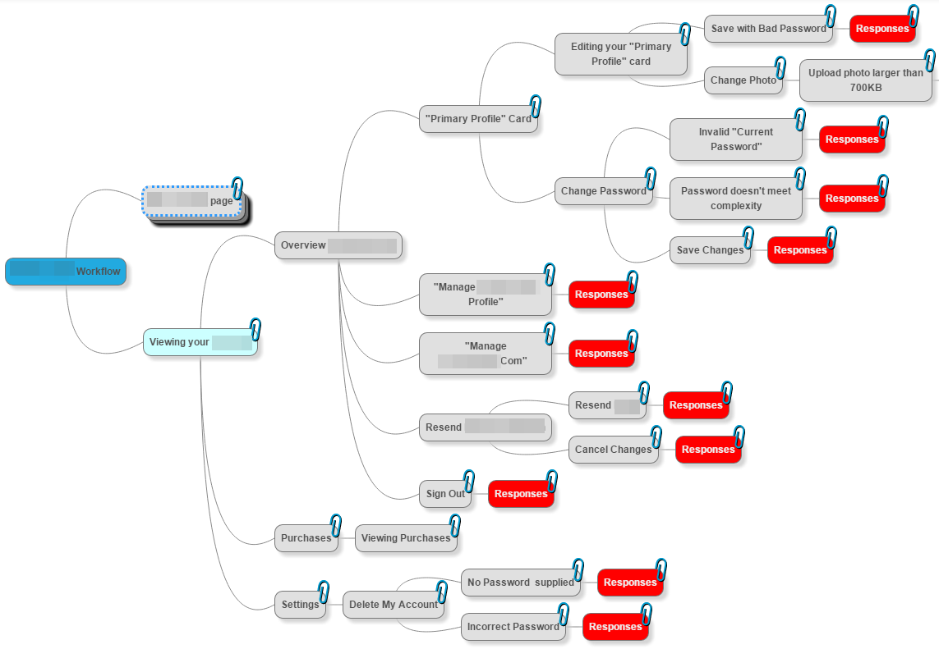
For tracking your test cases and execution results
Notes:
For test cases, you can take your design ideas and translate them in tests. Here is an example of a tester using a mind map to break out tests for an account workflow. Using the nodes to contain test charter or case details. Also using colors on the nodes to represent test execution results and test status. If red means failed tests, what can you infer from this image?

Slide 32
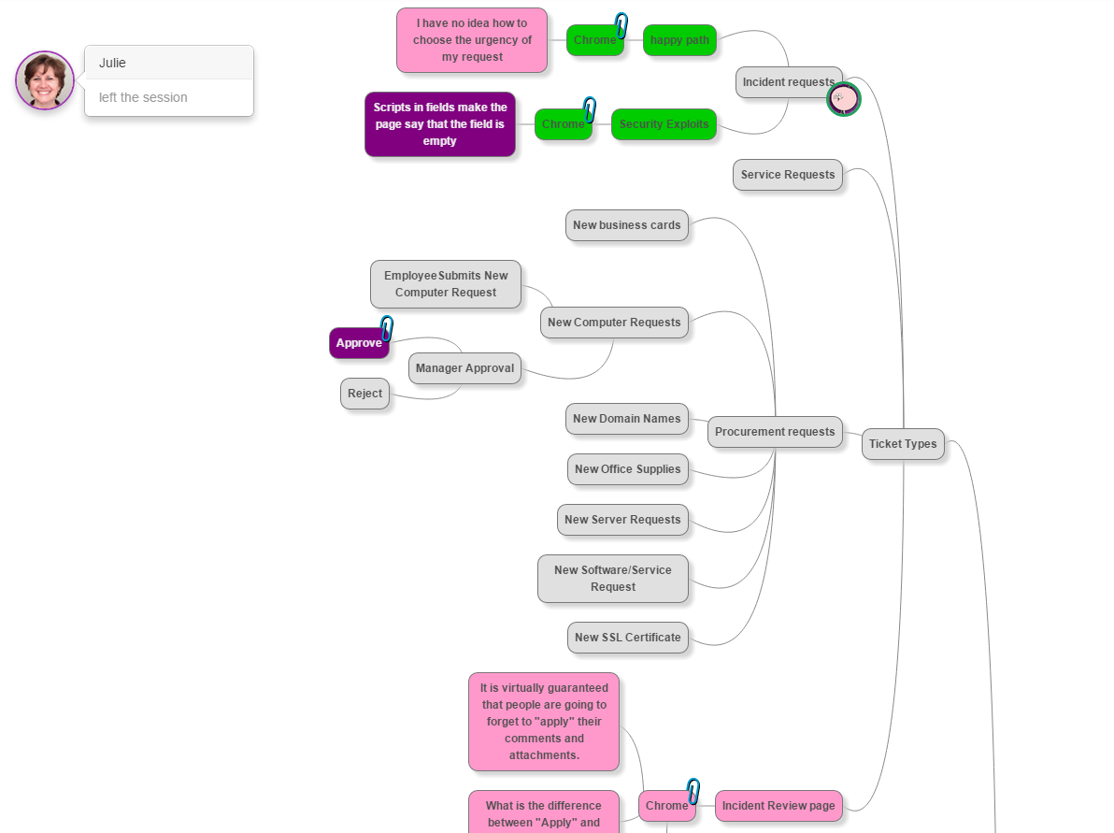
Notes:
This was an active test design and execution session for our IT staff’s new ticketing system. One tester built the initial map and others jumped in and crowdsourced the remaining test design and execution simutaneously. You can see who is working where, where the questions are, what’s been tested…

Slide 33
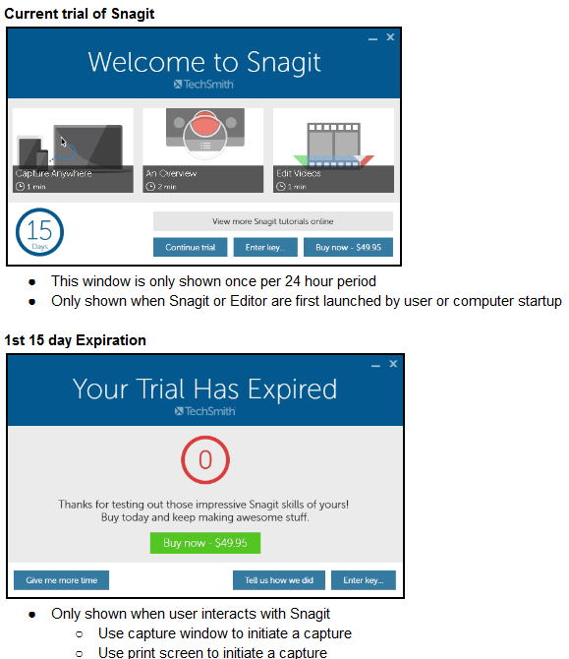
For tracking your test session notes or test results
Notes:
Test Session Notes and Results During Test Execution
Using images embedded in test session and results notes during test execution for retention purposes. I once worked at an insurance company and our testers used this method of capturing test results to satisfy audit purposes.
In Snagit I use the “Send to Word” profile and set a hotkey to shoot images automatically into a doc of test result images. It saves me time so that I don’t have to spend a lot of time typing up detailed results info.

Slide 34
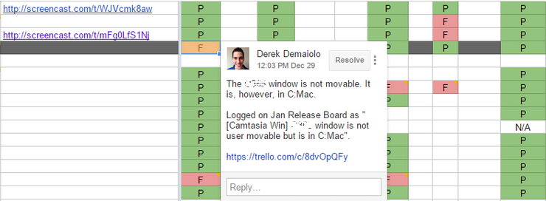
To represent collaboration on regression test cycles
Notes:
To represent collaboration on regression test cycles. One of our teams did a whole team regression test. They used a simple Google sheet with colors to represent test status, it was great for quick conversation on status and coverage.

Slide 35

To screen record test sessions and share features
Notes:
Test Execution – Recording Test Sessions can be valuable so that you can retrace your steps and grab elusive errors that may have instantly flashed across the screen. Also make sure to record both system audio and use your mic. That way you can narrate any thoughts about your test experience.
Sharing Product Knowledge to Other Testers and Team Members
My team members record short videos with narration to share out new features so that the whole team - other testers, support staff can “level up” their product knowledge. Here is a tester expressing functionality to share with others by screen capturing and narrating the feature in action.

Slide 36
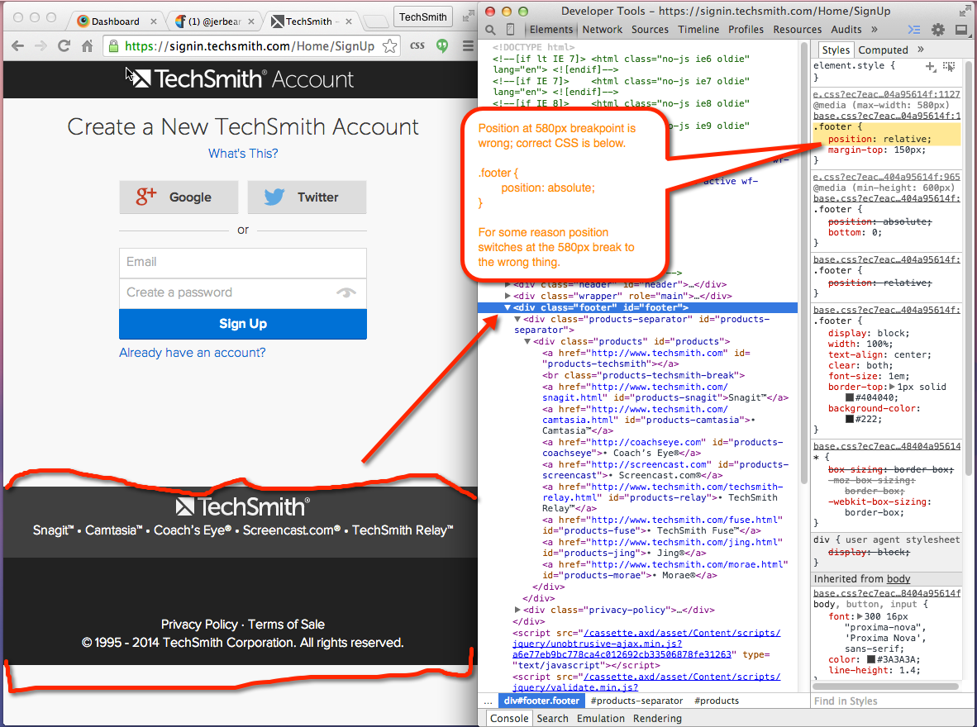
Bugs can be referenced as pictures
Notes:
Bugs can and should be referenced as pictures, not simply text. Remember, things get lost in translation when using words or text only. Here a tester displays a bug with a pixel breakpoint - where the problem is manifesting itself, then points to what the problem is, then shows where in the code it resides. Now I’m not claiming that every tester would diagnose, but this is an incredibly simple way to express a bug to a developer – as agile as possible – and in less time that it would take to even type up the bug in a tracking system.
Tips – call attention to areas of interest using callouts, arrows and highlighting.

Slide 37
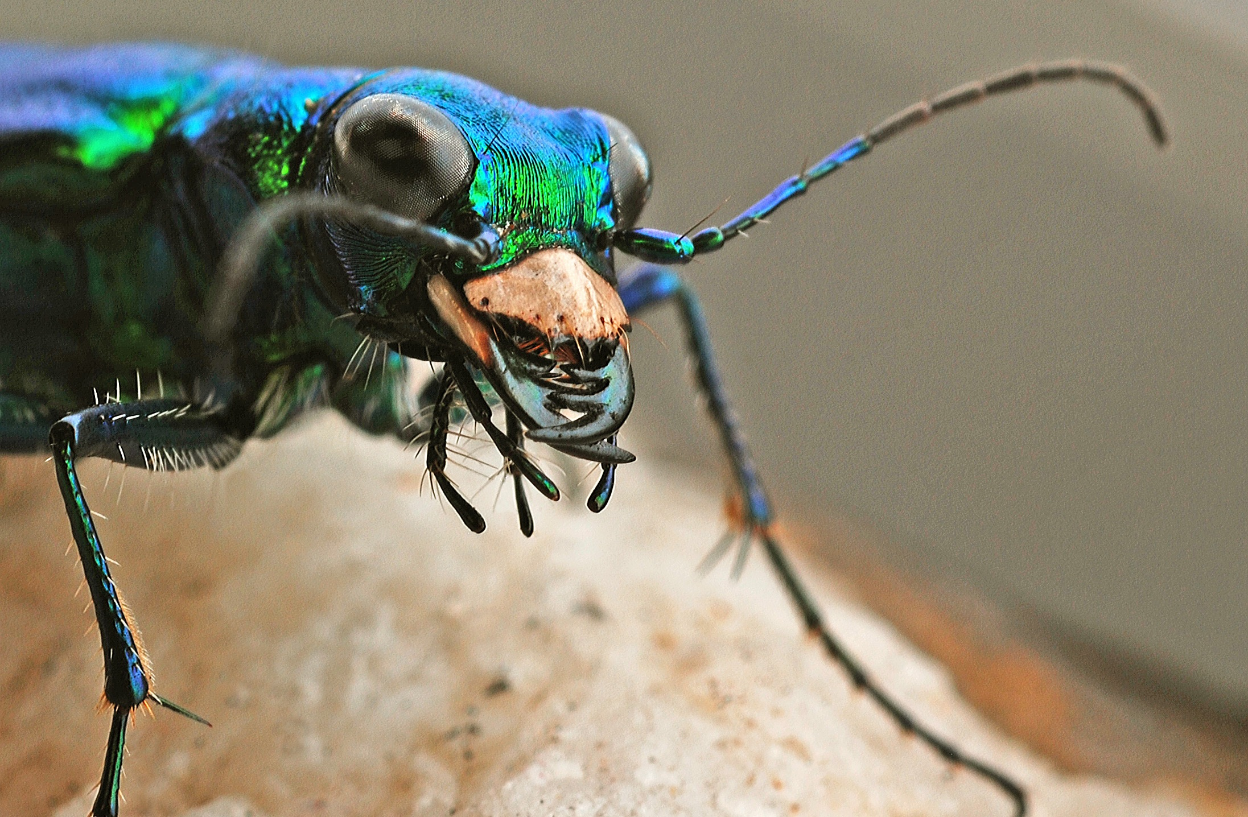
To provide narrated videos of the ugly bugs
Notes:
Have you ever heard a developer say, “well it works on my machine.” I’ve often seen an ugly bug volley back and forth in the tracking system.
Those words are typical of an ugly bug. I say Video report a bug! Video of the bug occurring along with a narration of tester’s experience is so much more powerful than a written description. And it’s hard to argue with video proof. Tip – keep videos short < 3 minutes – otherwise people might not want to watch them.

Slide 38
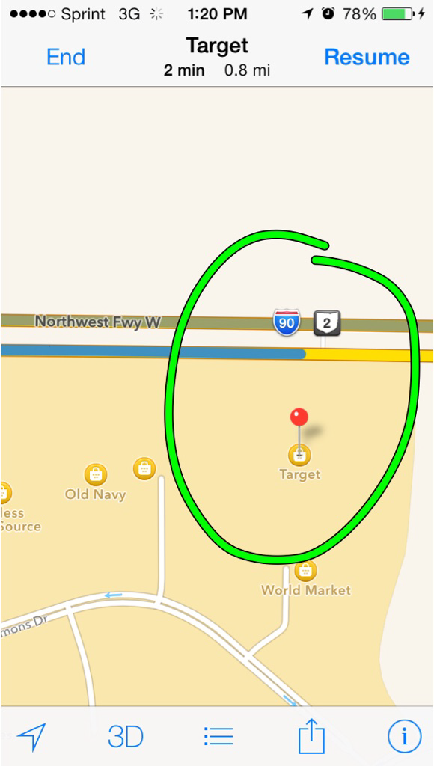
Mobile - Take pictures of test steps and bugs on your device and transfer them to your computer
Notes:
Take screenshots on your mobile device during test execution – for test results documentation or capturing bugs. Then, transfer the images to your computer to document test steps for mobile applications. Iphone – power and home button. Android – Power and Volume down key
I use my company’s free product Fuse that integrates with Snagit or Camtasia for easy transfer. You can either do basic edits and annotations on the device or just do a push from your device right in to Snagit for further edits or storage purposes.

Slide 39
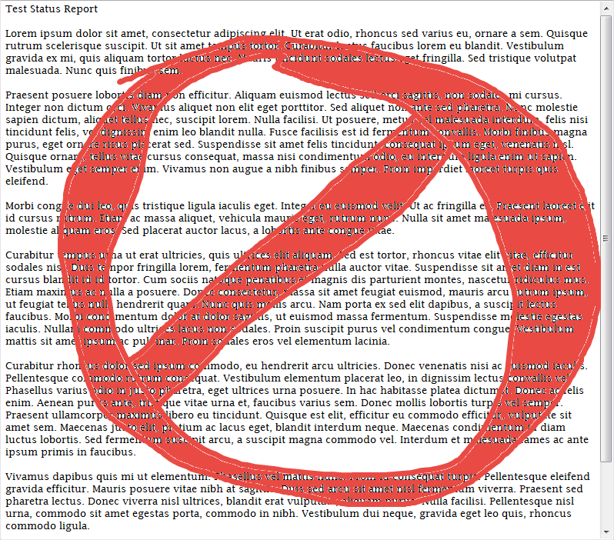
Notes:
Communicating Test Status
My stockbroker deals in securities. My testers deal in information. They are information brokers! They are purveyors of the quality aspects of the software as well as testing coverage and status of test execution. Please do not do this to your test manager, project managers, team members, or executives. You spend hours on it and no one is going to read this status report!

Slide 40
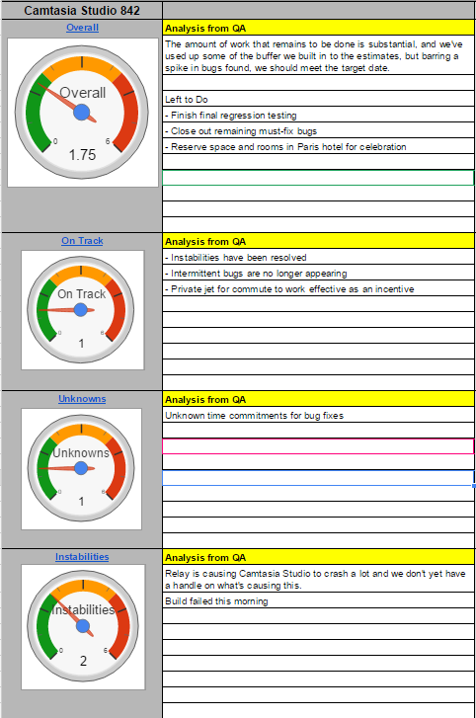
Communicating Test Status, Risk, and Quality
Notes:
Use a simple dashboard to drive conversation! Visual indicators draw the eye to actionable quality information. Managers, stakeholders, and team members are pulled into conversations around visual indicators. In this example the testers have some drill downs to additional information I might want to see.
Tip - If you want to know what to communicate I suggest googling James Bach’s Low Tech Testing Dashboard.

Slide 41

Communicate Application Quality via Symbols
Notes:
On one of our mobile teams the tester was communicating application quality using weather symbols. It was less of a forecast and more of a current conditions report. I was truly amazed as to how this helped the team work together. On a whiteboard visible to the team she would draw a symbol and have some anecdotal information next to it: Bug numbers and application area test status. Severe bugs, instabilities, and crashes would give you a thunderstorm. When the application areas were functional and performing well, the quality would show as bright and sunny. Maybe the team would even get a smiley and a rainbow. The team discussed - What do we need to do to get from the thunderstorm to the shining sun.

Slide 42

Communicate visually because…
Words can be confusing
Your ideas land with power
Save time
Bring people together
People retain more of what you communicate

Slide 43
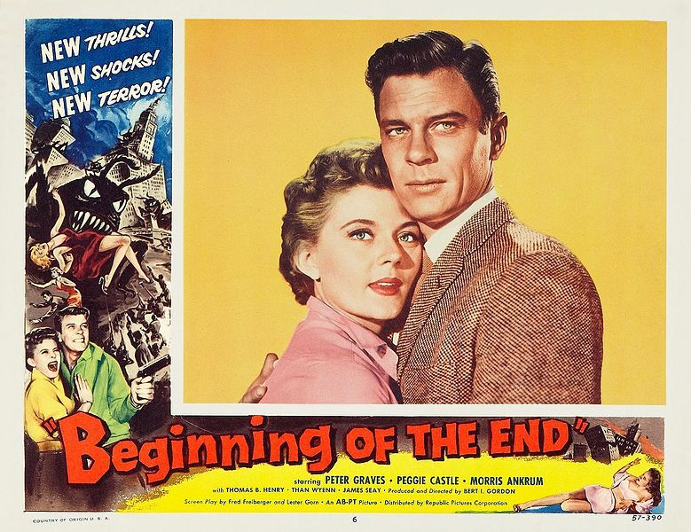
Thank You!
Jess Lancaster
TechSmith Corporation
@jessclancaster
http://www.linkedin.com/in/jesslancaster
Notes:
It is the end for me…and its just beginning for you. Don’t be afraid! Take some of these tips and techniques and try them out. I guarantee you will find one or two of them that will speed up some routine tasks!
{Information |Description ={{en|1=Peggie Castle (aka Peggy Castle) & Peter Graves in ''Beginning of the End'' - promotional poster}} |Source =[http://www.ebay.com/itm/THE-BEGINNING-OF-THE-END-PETER-GRAVES...

Slide 44
Credits
Show It!: Better Testing Through Visual Communication, presentation © Jess Lancaster 2015-2016.
Credits
Major Points to be considered: “Effective Visual Communication” by Sinoj Mullangath http://www.slideshare.net/sinojm/effective-visual-communication
Images:
All images public domain/stock photography or of my own creation, exceptions are:
Slide 4 and Slide 11: "Bestias11" by Clemens Schmillen - Own work. Licensed under CC BY-SA 3.0 via Wikimedia Commons - http://commons.wikimedia.org/wiki/File:Bestias11.JPG#mediaviewer/File:Bestias11.JPG
Slide 5, 6, 7, 8, 9 – “History of Visual Communication” by Elif Ayiter http://www.citrinitas.com/history_of_viscom/index.html
Slide 15 - http://www.examiner.com/article/confusing-and-misused-words-principle-and-principal
Slide 17 – “The Power of Visual Communication” by Hewlett-Packard. http://www.hp.com/large/ipg/assets/bus-solutions/power-of-visual-communication.pdf
Slide 41 - http://denmark.dk/en/meet-the-danes/ninetips/

